Slide 1
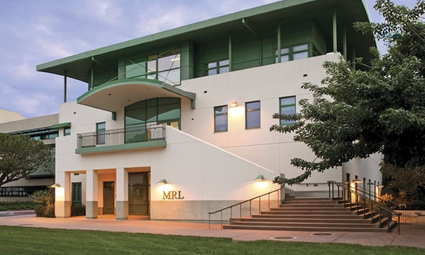
MATERIALS RESEARCH LABORATORY AT UCSB: AN NSF MRSEC
Shared Experimental facilities
www.mrl.ucsb.edu
1

Slide 2
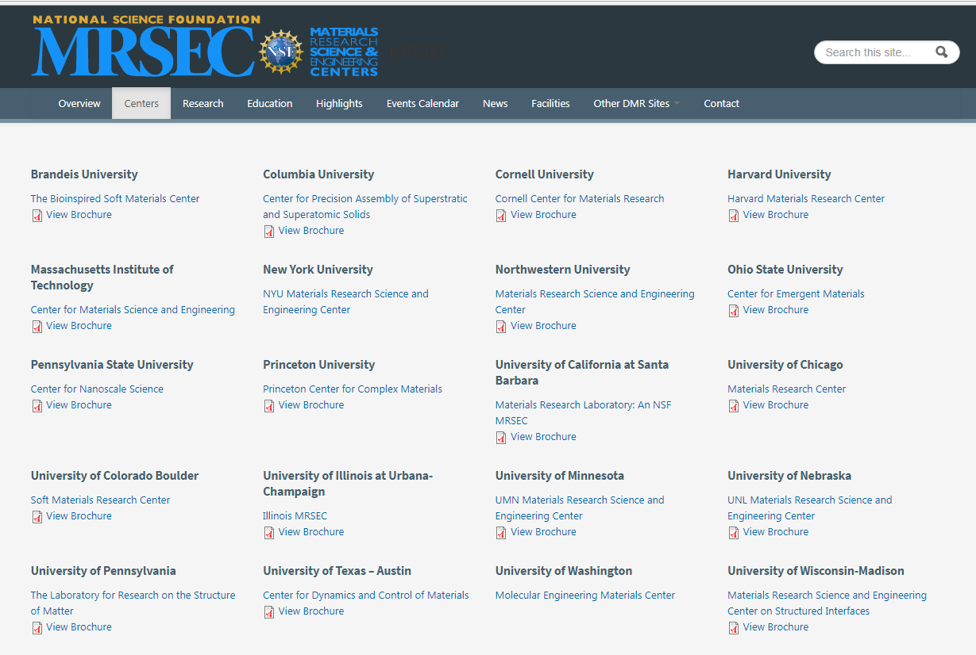
In 2017, NSF awarded funding to eight Materials Research Science and Engineering Centers (MRSECs) for transdisciplinary work that covers all areas of materials science and helps foster collaborations on a national and international level. These six-year awards represent a significant new investment in material science exceeding $145M. (www.mrsec.org )
6th Renewal!!!

Slide 3
SEFs: Core Principles
Central, open-access, shared facilities with state-of-the-art instrumentation:
  Equal access, training and support for ALL users
  Recharge basis
  20+ publications by Technical Directors & staff
  Active in education and outreach
  Support for instrumentation development
  Over 600 publications from SEFs
  (DMR 1121053, excludes IRG/Seed research)
  Over 60 publications citing DMR 1720256 (new grant starting 2017)
Support:
MRSEC funding is critical to maintaining world-class and constantly-evolving SEFs and is leveraged for staff support and facility and equipment upgrades.
New instruments supported by MRSEC, and additionally, NSF MRI, NIH, MC-CAM, Dow, UCSB campus contributions, PI start-up and donations, external (non-University) recharge income
3

Slide 4
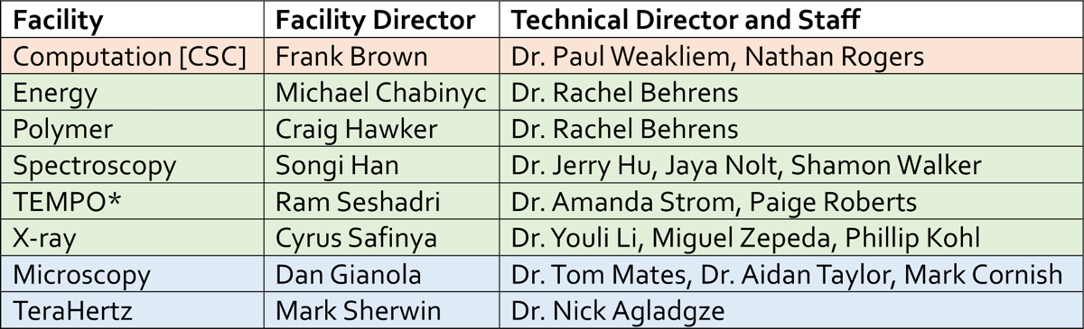
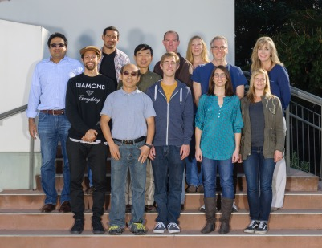
UCSB SEF: Description of the Facilities
Dedicated staff contributing through training, research, education and outreach.
Run jointly with the California NanoSystems Institute (Director: Hawker)
Partner facilities
*TEMPO = Thermal Electronic Magnetic Porosity Optical
3/1/2016 to 2/28/2017: 803 total users billing 39,906 recharge hours. 8272 of the total hours (20 %) were external (non UCSB) users.
Support model for staff:
70 % from facilities recharge
15 % from the MRSEC grant
15 % from UCSB and other
March 2015. Partner facilities staff not in picture.
4

Slide 5
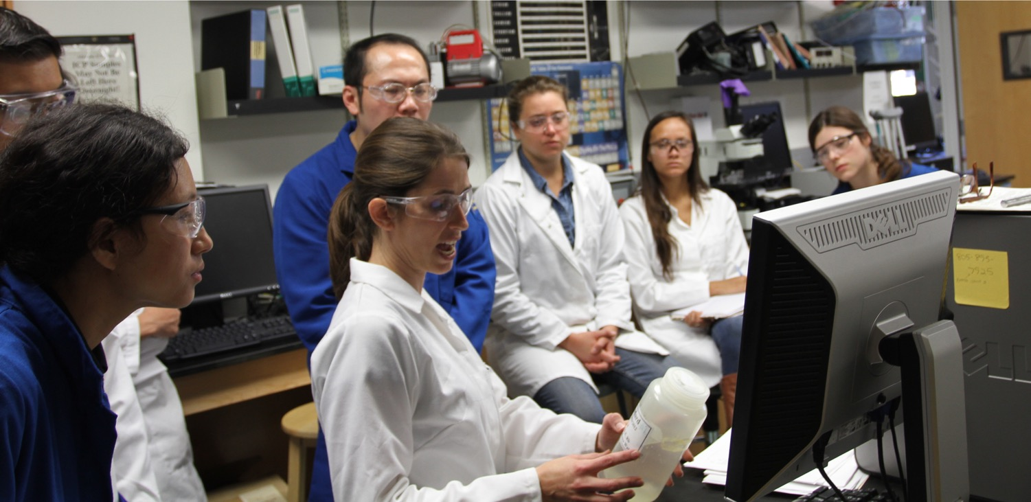
Shared Experimental Facilities (SEFs) and MRFN (coordinated by Craig Hawker)
Dr. Amanda Strom, Technical Director of the TEMPO facility, training users on ICP-AAS.
5

Slide 6
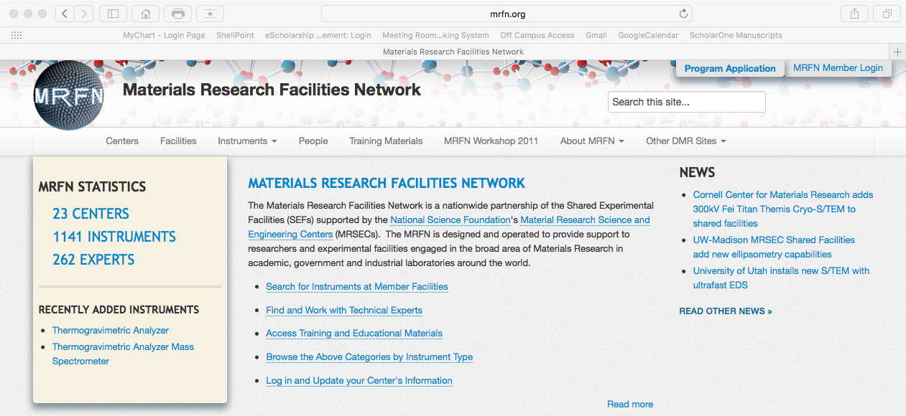
Materials Research Facilities Network: Continued Leadership
Recent screengrab of the MRFN website.
www.mrfn.org
6

Slide 7
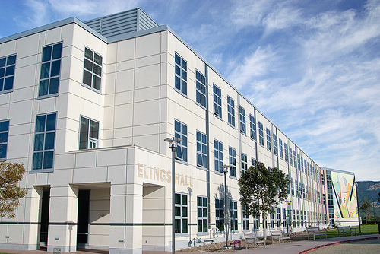
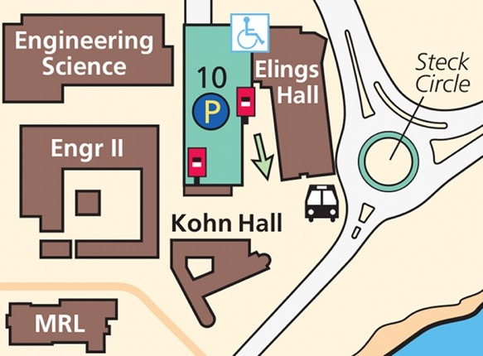
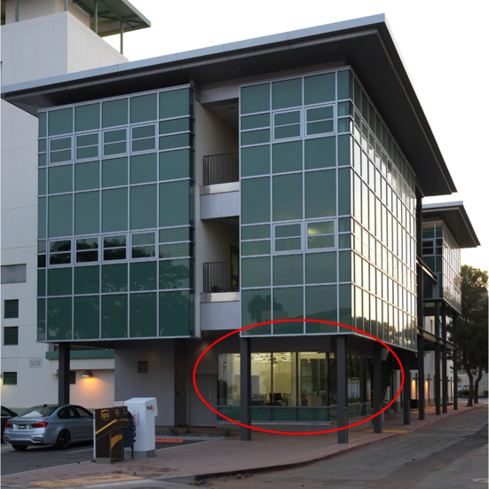
SEFs: Total Space Exceeding 20,000 ASF
Elings Hall
Microscopy and Microanalysis (Partner Facility)
Spectroscopy (NMR, ESR)
X-Ray (powder and thin film)
Computation (Partner Facility)
Energy (photovoltaics)
MRL Building (new 2,000 ASF infill space is circled)
TEMPO [Thermal, Electronic, Magnetic, Porosity, and Optical]
Polymer
X-Ray (small and wide angle)
Energy (batteries and supercapacitors)
7

Slide 8
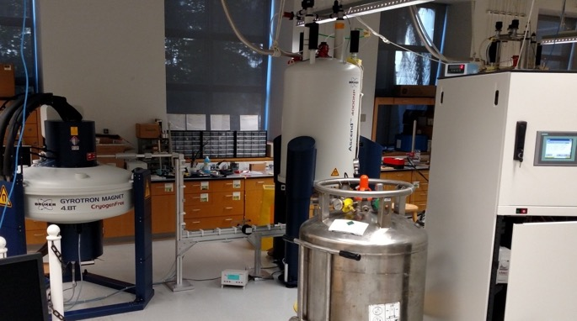
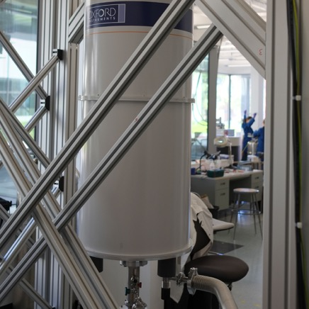
SEFs: Recent and Planned Acquisition
400 MHz/ 263 GHz DNP ssNMR: NSF-MRI led by Chmelka (also see IRG-3).
Unique for a shared facility in the US.
14 T/10 mK closed-cycle system from Oxford: NSF-MRI led by Stemmer and Wilson.
Unique for a shared University facility in the US.
Future plans include acquisition of GPU computing nodes, an ultrafast (100 kHz) MAS NMR spinning probe, a thermal conductivity measurement system, and new detectors for scanning electron microscopy.
8

Slide 9
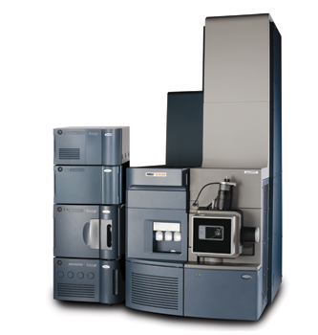
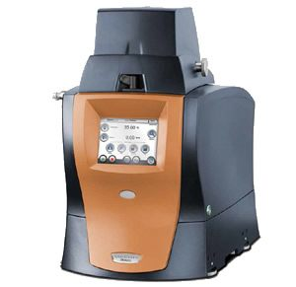
SEFs: Recent Additions in the Polymer Characterization Facility
2015 Acquisition: Waters Acquity H-class UPLC with Xevo G2-XS ToF
2017: Upgrade to Q-ToF
2017 Acquisition: TA Instruments Dynamic Mechanical Analyzer (DMA850)
2016 Acquisition: Waters Acquity Advanced Polymer Characterization (APC) instrument

Slide 10
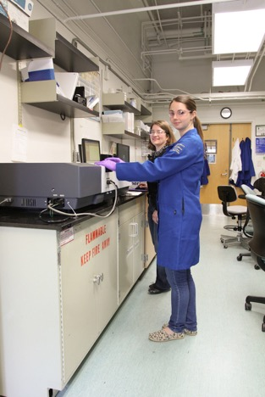
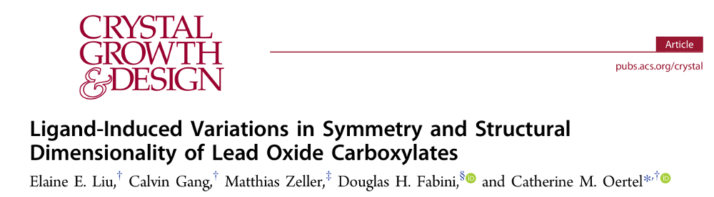
UCSB SEF: Usage Examples
The SEFs play a crucial role in education and training (including of undergraduate interns), in supporting start-up companies, sustaining our longer-term industrial partnerships (Mitsubishi and Dow), and engaging with our PREM partners.
External (larger) Industry: Allergan, Chevron, CREE, Honeywell, Lockheed Martin, Nusil, Raytheon, Soraa … Start-ups: Apeel, Fluency Lighting, Next Energy Technologies, Milo Sensors, Soraa Laser … (90 companies total). ; External Academia: Berkeley, Cal Poly SLO, Caltech, Northwestern, Oberlin College, Washington University … (25+ institutions)
Professor Catherine Oertel (Oberlin College) and Kristin Denault (former UCSB graduate student) at the TEMPO facility.
Kristin continues to use the SEFs to advance for her start-up company.
NSF 1121053 acknowledged.
10

